Slide 1
Animals that have backbone are called as Vertebrates

Slide 2
Vertebrates are divided into five groups
Mammals – young ones are born alive
Birds – covered with feathers and lays egg
Reptiles – move along the ground and lays egg
Fish – aquatic animals that breathe through gills
Amphibian – lives in both land and water and lays egg on water

Slide 3
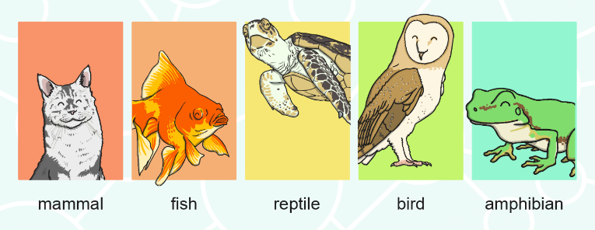
Five groups of vertebrates
Mammals
Fish
Reptiles
Birds
Amphibians

Slide 4
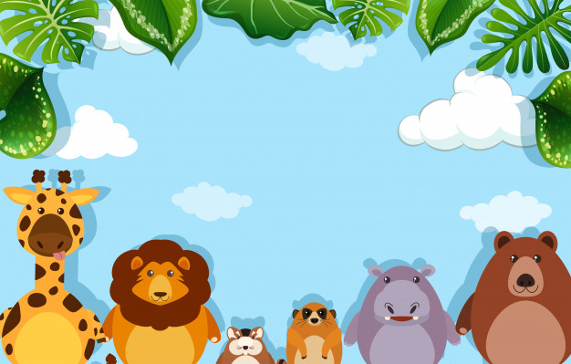
Mammals

Slide 5
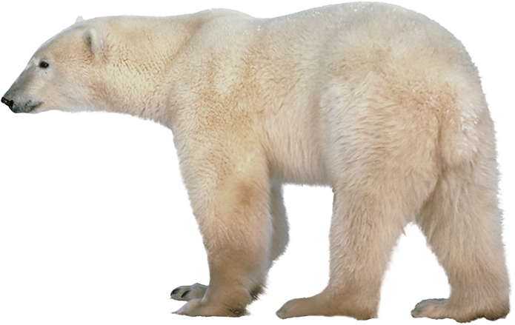
Mammals are covered with hair or fur

Slide 6
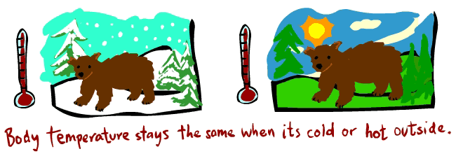
Mammals are warm blooded animals

Slide 7
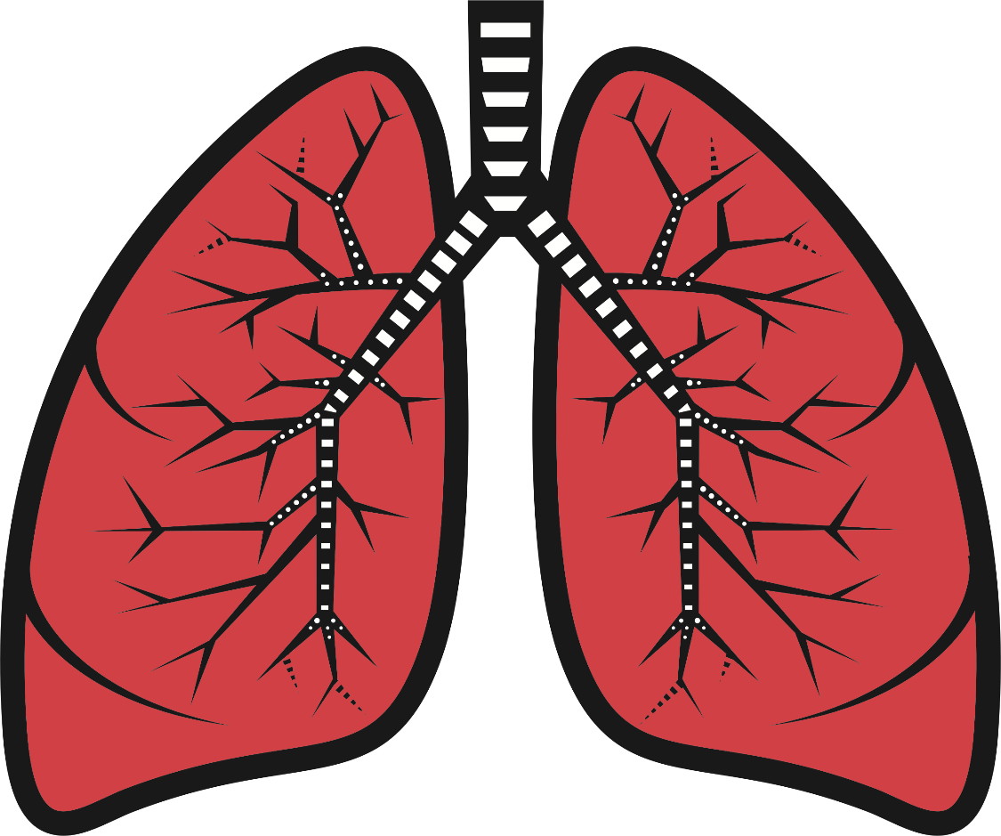
Mammals breathe through lungs

Slide 8
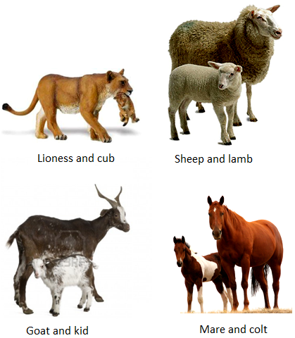
Mammals do not lay egg, they give birth to young ones

Slide 9
Mammals produce milk for their young one

Slide 10
Examples of mammals

Slide 11
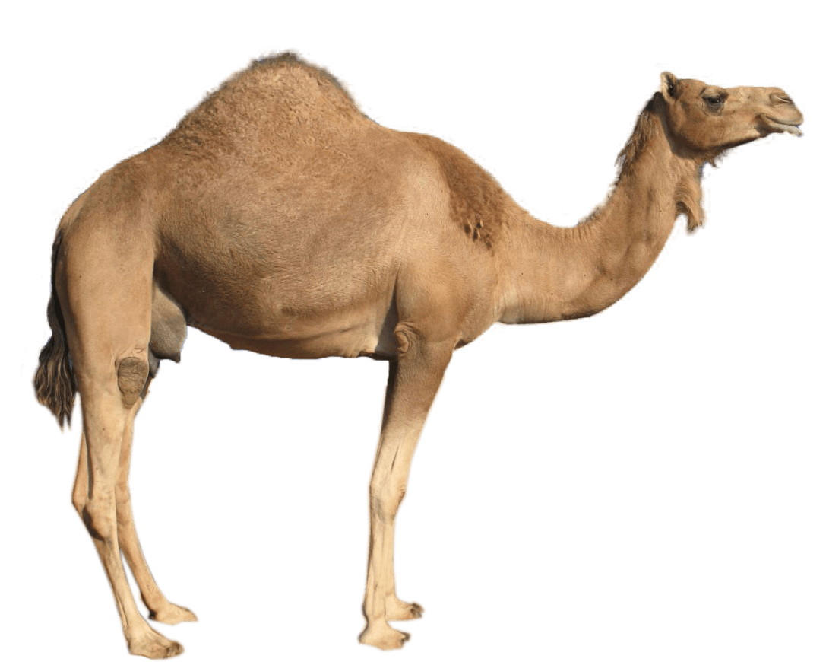
Camel

Slide 12
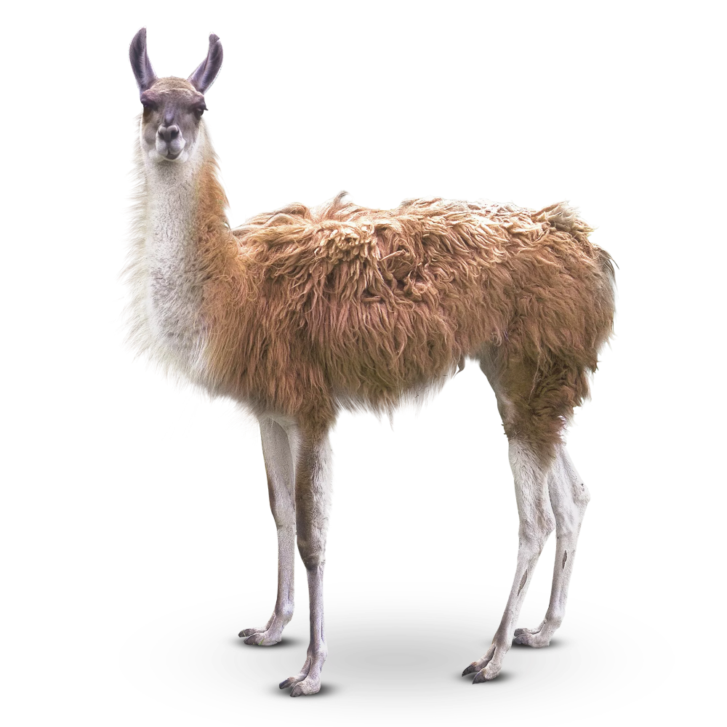
IIama

Slide 13
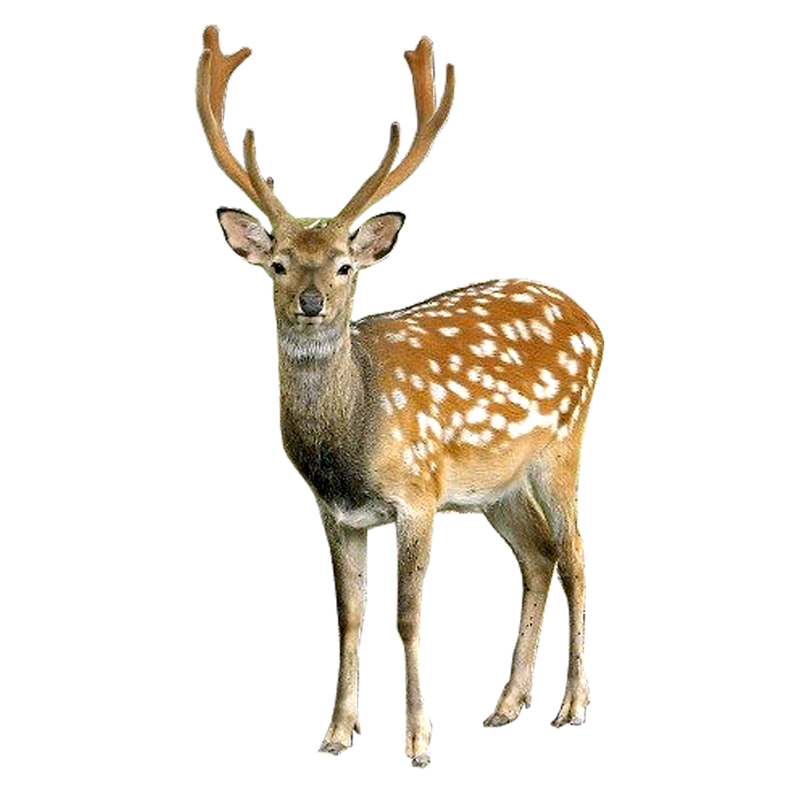
Deer

Slide 14
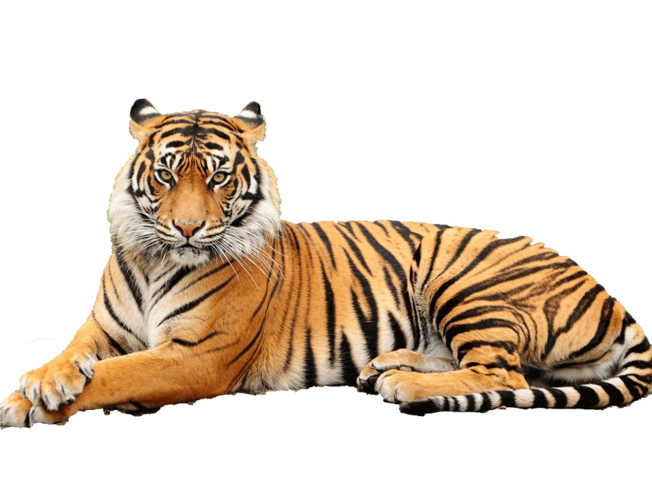
Tiger

Slide 15
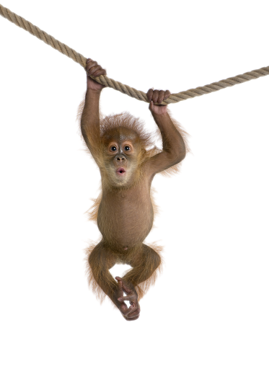
Monkey

Slide 16
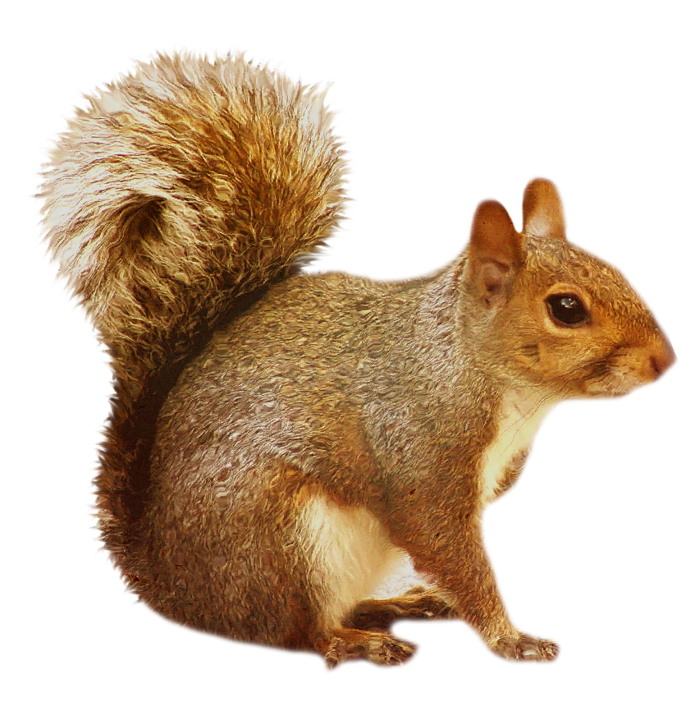
Squirrel

Slide 17
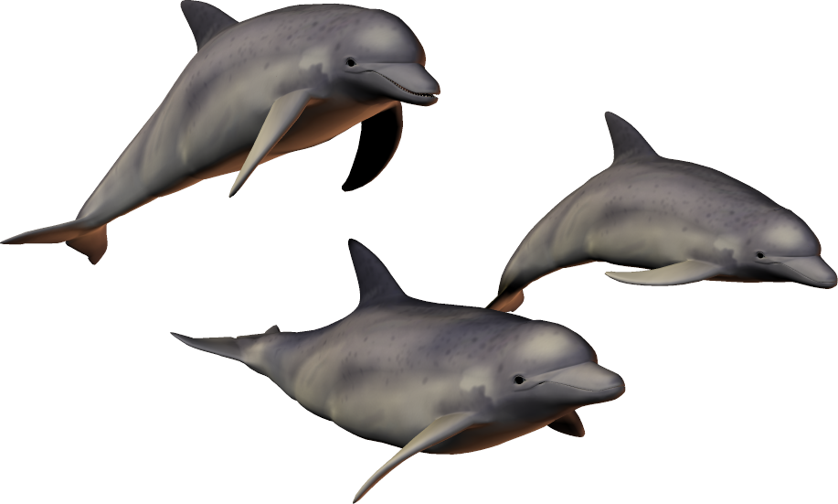
Dolphins

Slide 18
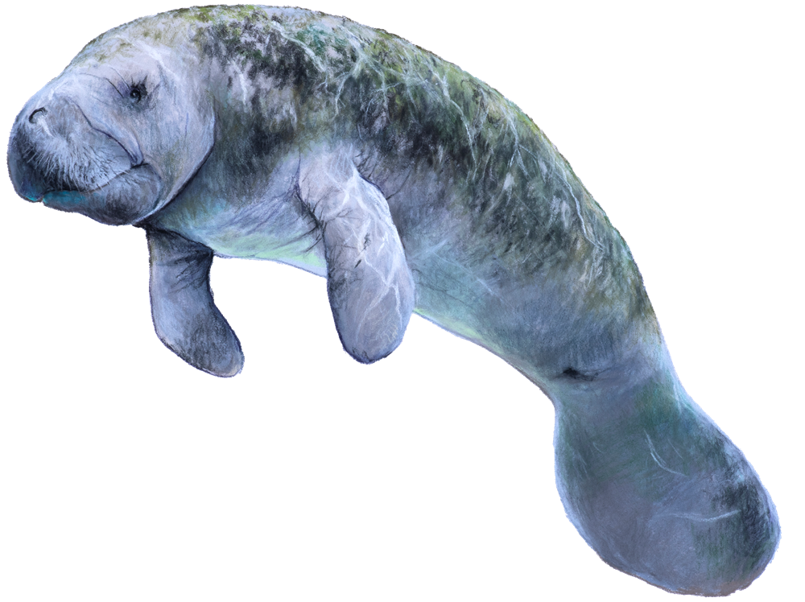
Manatee

Slide 19
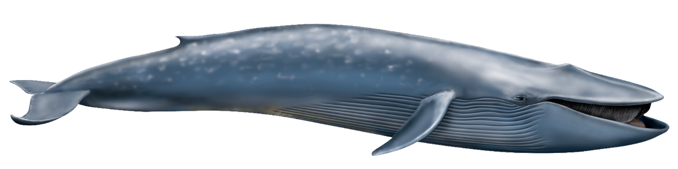
Blue whale

Slide 20
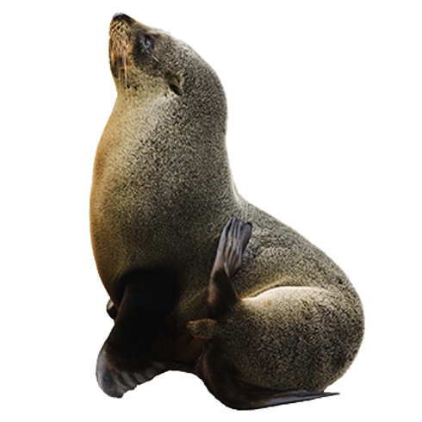
Seal

Slide 21
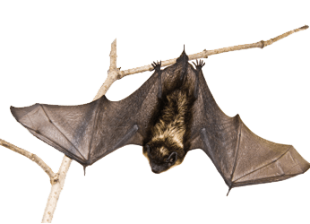
Bat

Slide 22

Human beings

Slide 23
Facts on mammals

Slide 24
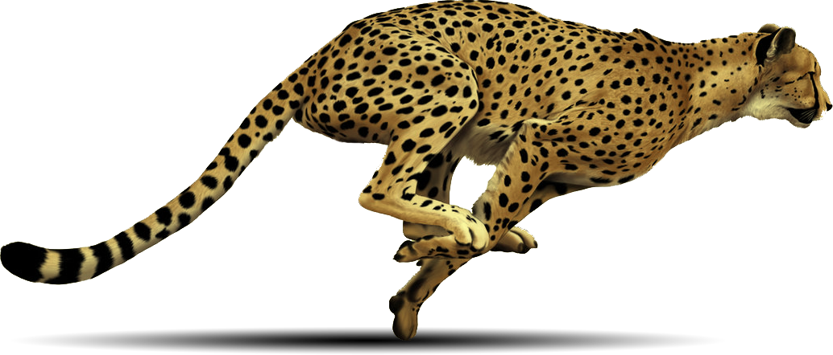
The fastest mammal
Cheetah is the fastest mammal (also the fastest land animal).

Slide 25
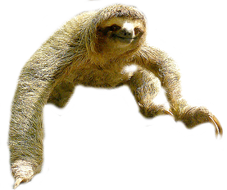
The slowest mammal
Slowest mammal is the sloth.

Slide 26
The biggest mammal
The biggest mammal (also the biggest animal) on Earth is the blue whale.

Slide 27
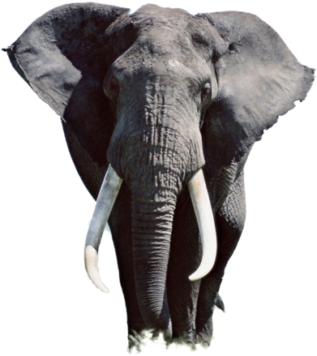
The biggest mammal
The biggest land mammal is the African elephant.

Slide 28
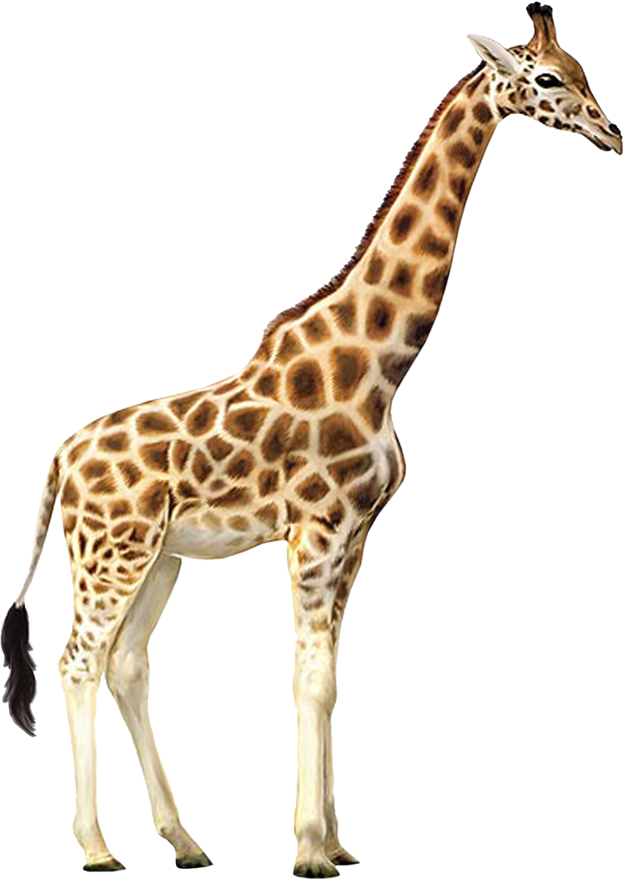
The tallest mammal
The tallest mammal is the giraffe.

Slide 29
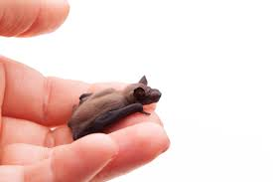
The smallest mammal
The bumblebee bat is the smallest mammal.

Slide 30
The loudest mammal
The loudest mammal is the Blue whale.

Slide 31
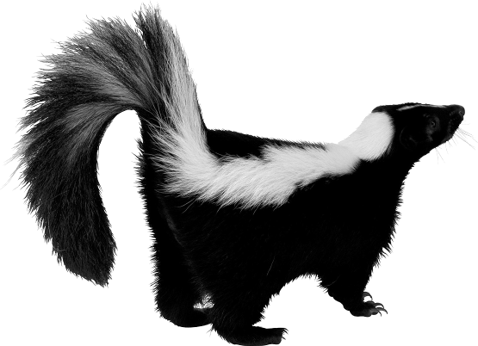
The smelliest mammal
The smelliest mammal is the skunk.

Slide 32
The most intelligent mammal
Human beings are the most intelligent mammals on Earth

Slide 33

Homework
EVS 1A Workbook
Page 62

